Slide 1
Student Portfolio
STUDENT NAME: SATHIYA.E
REGISTER NO AND NMID: asanm225anm22524132251802522047
DEPARTMENT: B.SC COMPUTER SCIENCE
COLLEGE: GOVERTNMENT ARTS AND SCIENCE COLLEGE,VANUR/ANNAMALAI UNIVERSITY CHITHAMBARAM

Slide 2
PROJECT TITLE A CREATIVE STUDENT PORTFOLIO

Slide 3


AGENDA
Problem Statement
Project Overview
End Users
Tools and Technologies
Portfolio design and Layout
Features and Functionality
Results and Screenshots
Conclusion
Github Link
3/21/2024 Annual Review

Slide 4

PROBLEM STATEMENT
IN TODAY’S COMPETITIVE ACADEMIC AND PERFESSIONAL ENVIRONMENT, STUDENTS NEED A PLATFORM
TO SHOWCASE THEIR SKILLS, ACHIEVEMENTS, AND PROJECTS IN AN ORGANIZED MANNAR. HOWEVER,
MOST STUDENTS RELY ONLY ON TRADITIONAL RESUMES OR PAPER-BASED CERTIFICATES, WHICH
ARE OFTEN INSUFFICIENT TO HIGHLIGHT THEIR COMPLETE POTENTIAL.

Slide 5

PROJECT OVERVIEW
THE STUDENT PORTFOLIO PROJECT AIMS TO CREATE A DIGITAL PLATFORM WHERE STUDENTS
CAN SHOWCASE THEIR ACADEMIC QUALIFICATIONS,TECHNICAL SKILLS, ACHIEVEMENTS ,
PROJECT,AND PERSONAL DETAILS IN A PERFESSIONAL AND WELL-STRUCTURED FORMAT.UNLIKE
TRADITIONAL RESUMES,THIS PORTFOLIO PROVIDES AN INTERACTIVE AND VISUALLY
APPEALING WAY TO HIGHLIGHT A STUDENT’S COMPLETE PROFILE.

Slide 6

WHO ARE THE END USERS?
1.STUDENTS-PRIMARY USERS
2.TEACHERS/MENTORS-CAN REVIEW STUDENT PORTFOLIOS FOR ACADEMIC EVALUATION.
3.RECRUITERS/EMPLOYERS-CAN ACCES THE PORTFOLIO TO EVALUATE A STUDENT’S PROFILE,SKILLA AND PROJECTS.
4.EDUCATIONAL INSTITUTIONS-COLLEGES/UNIVERSITIES CAN USE PORTFOLIOS FOR ACCREDITATION,PLACEMENTS,AND SHOWCASING STUDENT TALENT.

Slide 7

TOOLS AND TECHNIQUES
FRONTEND DEVELOPMENT TOOLS
HTML5-TO STRUCTURE THE CONTENT OF THE PORTFOLIO.
CSS3-TO DESIGN AND STYLE THE PORTFOLIO(COLORS,FONTS,LAYOUTS).
JAVASCRIPT-TO ADD INTERACTIVITY(FROM VALIDATION,ANIMATIONS,DYNAMIC
CONTENT).

Slide 8
PORTFOLIO DESIGN AND LAYOUT
1.HEADER-NAME,LOGO,NAVIGATION MENU
2.HOME-SELF-INTRODUCTION WITH TAGLINE
3.ABOUT ME-BACKROUND AND CAREER GOALS.
4.EDUCATION-ACADEMIC DETAILS IN TIMELINE FORMAT.
5.SKILLS-TECHNICAL AND SOFT SKILLS.
6.PROJECTS-WORK SAMPLES AND PROJECT DETAILS.
7.ACHIEVEMENTS-CERTIFICATES AND AWARDS.
8.CONTACT-EMAIL,PHONE,SOCIAL LINKS,CONTACT FORM.
FOOTER-COPYRIGHT AND QUICK LINKS.
8

Slide 9
FEATURES AND FUNCTIONALITY
1.NAVIGATION BAR WITH SMOOTH SCROLLING.
2.ABOUT ME SECTION TO HIGHLIGHT PROFILE & SKILLS.
3.PROJECT SHOWCASE WITH IMAGES AND DETAILS.
4.INTERACTIVE ELEMENTS(HOVER EFFECTS,ANIMATIONS).
5.CONTACT FORM WITH VALIDATION & DIRECT MAIL OPTION.
6.RESPONSIVE DESIGN FOR ALL SCREEN SIZES.
7.DOWNLOADABLE RESUME OPTION.
8.SOCIAL MEDIA LINKS INTERGRATION.

Slide 10
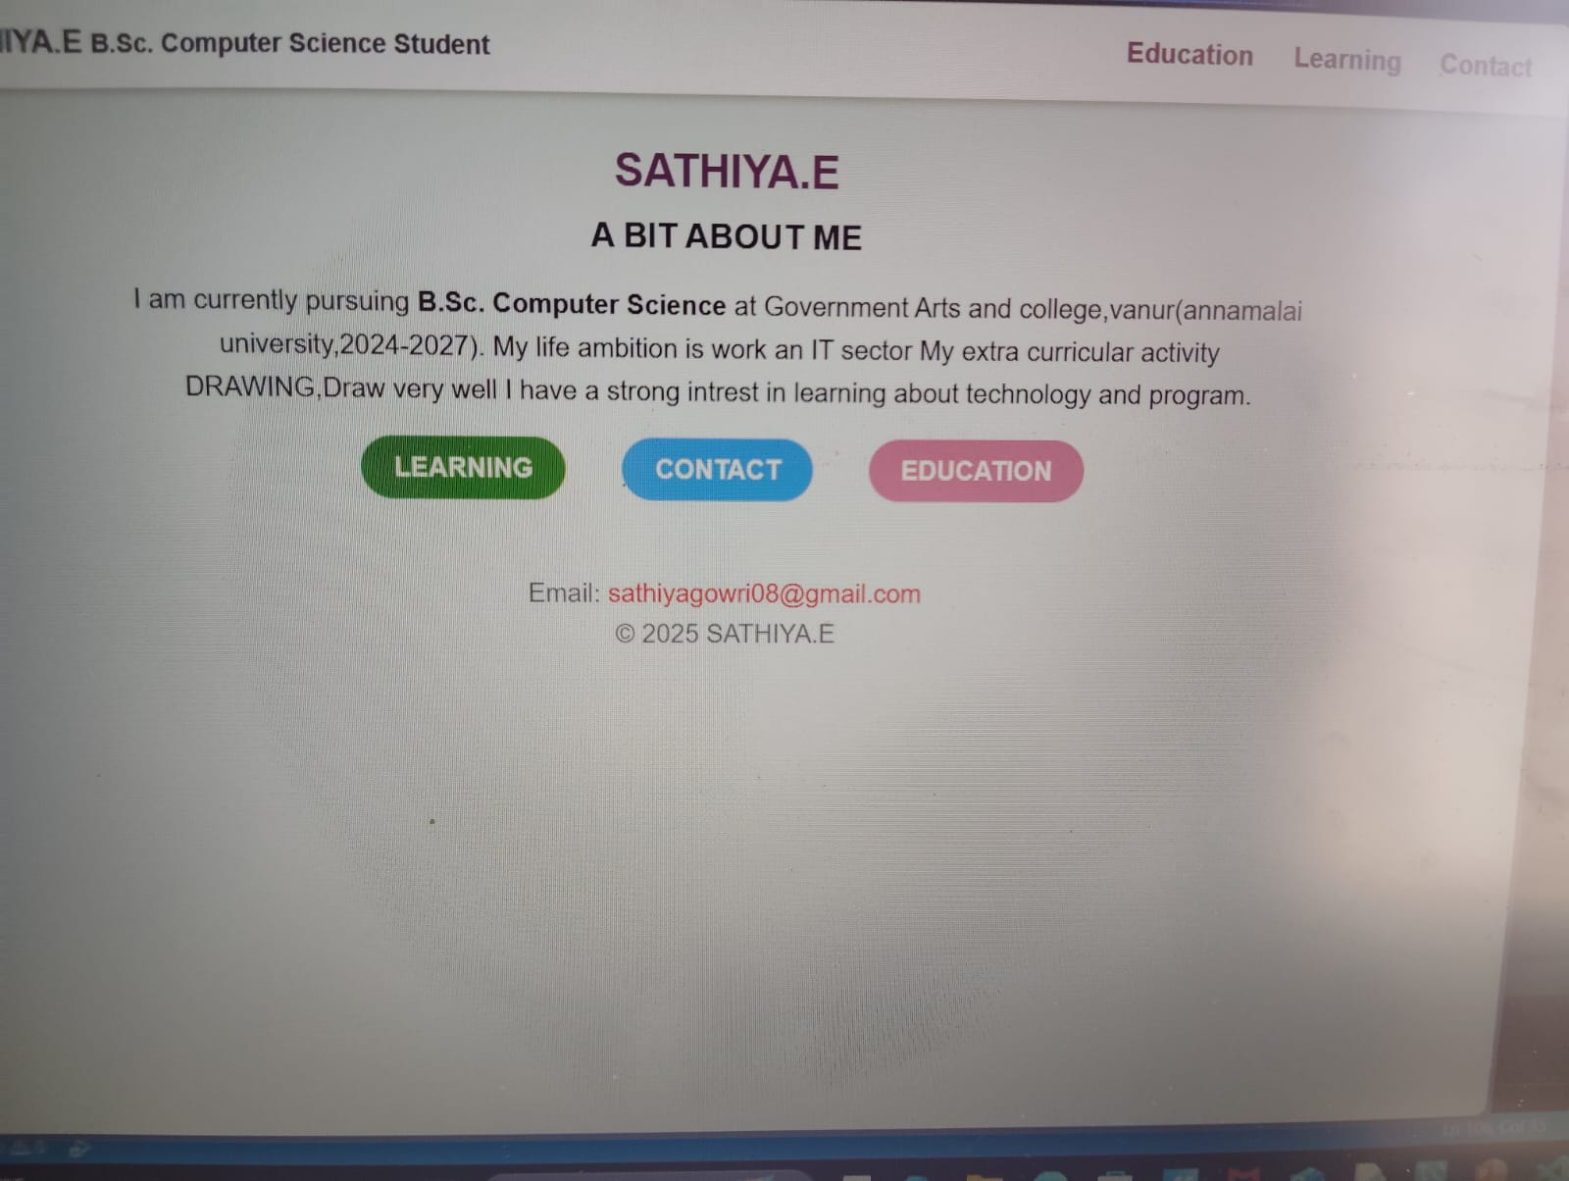

RESULTS AND SCREENSHOTS
3/21/2024 Annual Review
10

Slide 11
GITHUB
sathiyagowri08-netizen/Sathiya-TNSDC-FWD-DP

Slide 12
CONCLUSION
“THIS PORTFOLIO SERVES AS A DIGITAL SHOWCASE OF MY SKILLS,PROJECTS,AND PROFESSIONAL GROWTH”.
12

